Slide 1


Debt Collection
Team A
Patrick Meade, Sumatra Dhimoyee, Quan Ho, Yiyang Cai,
Andrew Woska - Team Rep
Notes:
10s

Slide 2
Background
There is a lack of comprehensive investigation regarding debt collection procedures within the Massachusetts court system.
By analyzing archived records, we can gain insight into how debt collection operates within the courts of Massachusetts
Looking at debt collection across the state of Massachusetts and looking into key questions provided to by WBGH

Slide 3
Key Tasks
How many cases have been filed each year over the last ten years in each court?
Patrick
What percentage of cases filed in small claims and district court are filed by debt collectors?
Andrew
How many cases go into default?
Sumatra
How many debtors are pro se?
Quan
How many cases lead to wage garnishes?
Yiyang
Notes:
30s

Slide 4
Current Progress
Debt collectors in small claims court: > 10.4%
List of known debt collectors being created
Maximal Number of debt collection cases: 1,232,611
Maximum Pro Se cases: 183,690

Slide 5
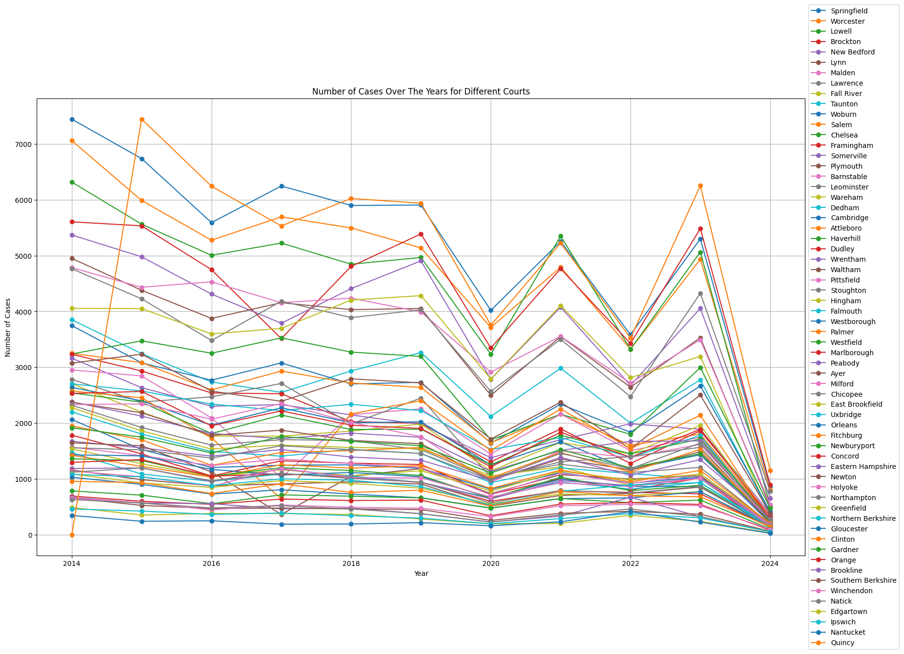
Number of case over the last ten Years
There has been a total of 1,167,365 cases in the last ten years.
We can see how for some courts, there was a dramatic increase in court filing, with a sudden decrease in 2020, which is most likely due to the start of the pandemic.
Notes:
30s

Slide 6
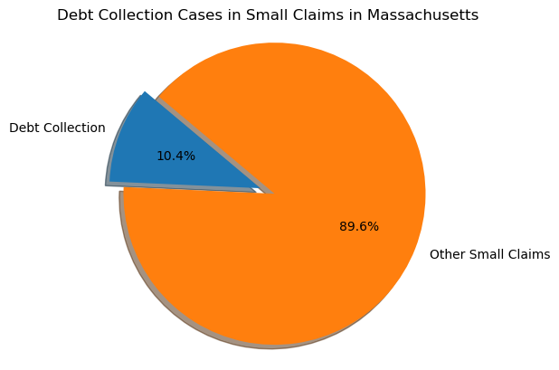
Small Claims Cases
There may be issues since the list of all debt collection companies is not fully known
Small Claims
1,590,000
Debt Collectors in Small Claims
165,000
Notes:
Values are approximate as they are subject to change on a daily basis

Slide 7
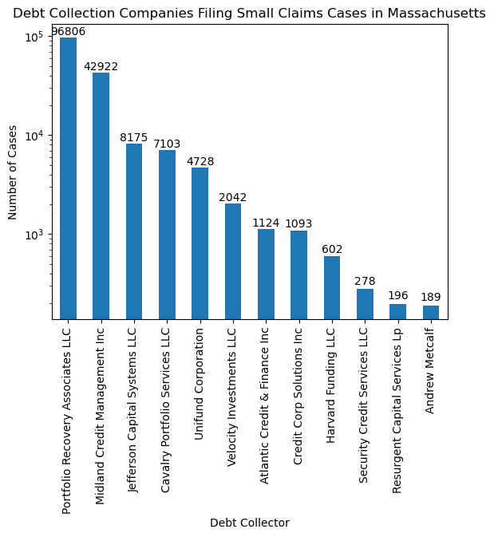
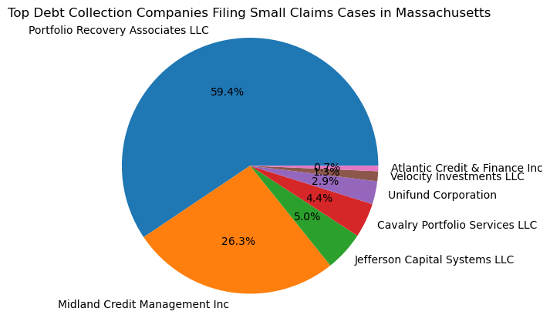
Notes:
Most companies are not even in the tri-state area but are responsible for most debt collection

Slide 8
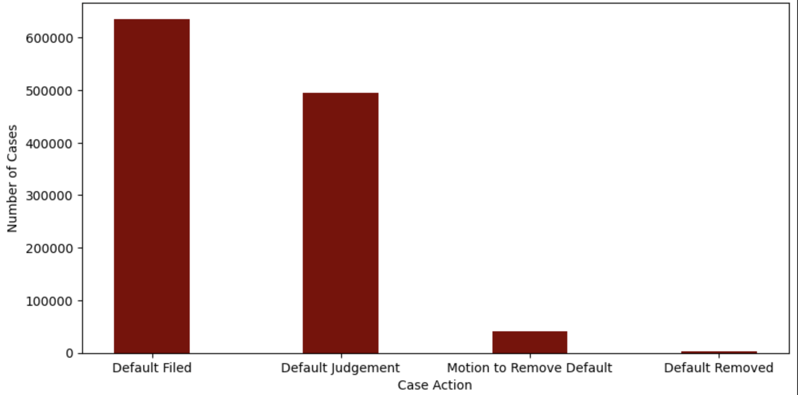
Default Case Analysis
Notes:
As you can see from the bar plot, while the number of cases that get filed for default judgment and receive the judgment are comparable, the number of instances that file motions to remove default judgment and eventually receive their default judgment revoked are significantly lower.

Slide 9
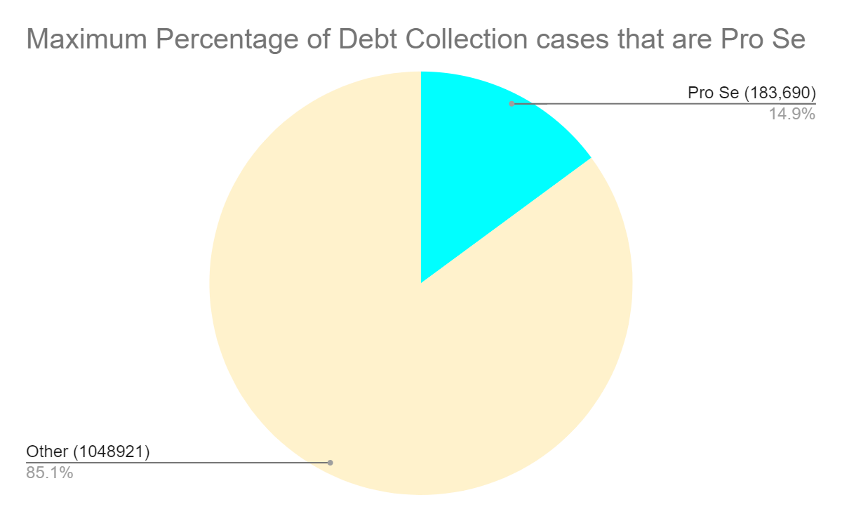

Slide 10
Challenges
Debt collection companies
Finding exact number of debt collection cases
Defining exactly what is a debt collection case and agreeing on the definition and parameters
Notes:
1m

Slide 11
Next Steps
We are transitioning to different questions while also reflecting on the pivotal questions that have been addressed and formulating new inquiries based on those responses.
Expand on current key questions
Find remaining debt collectors
Looking at population density over the years and comparing that to the provided data.
Can we do a breakdown about where the debtors live?
Find the mean, maximum, and minimum debt values that go into default
Find how many of those debtors that get default judgment file for bankruptcy
Find a minimal number of debt collection cases and minimal number of Pro Se cases
Find a way to extract information for each case number so it can identify debt better.
Find the actual number of Wage Garnish in all cases
Evaluate the possibility of using a language model to help classify the Wage Garnish type
Notes:
1m

Slide 12
Resources
MassCourtsPlus.org
mass.gov

Slide 13
Questions?

